Slide 2

Whiteware glazing and additives

Slide 3
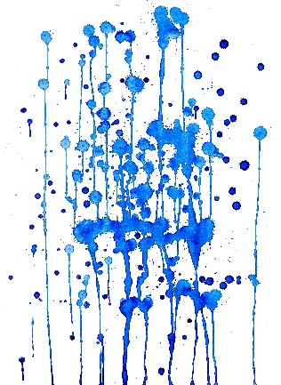
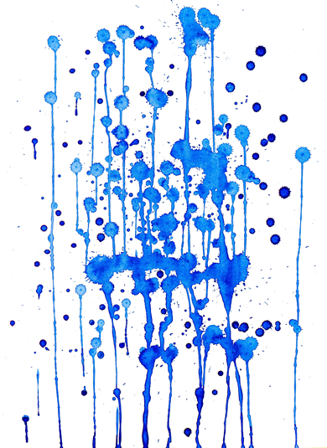

Glaze requirements
To prepare, to stock and to apply glaze slips for sanitaryware in a technically and
economically convenient way presents a list of ideal requirements:
Glaze preparation:
Short grinding time
Short unloading of the mill and sieving time
User friendly addition of additives (binders etc.)
Glaze storage:
No settling in tanks and containers
Quick setting and stability of glaze parameters

Slide 4
Glaze requirements
Glazing by spraying onto sloped or vertical surfaces:
High flow capacity of the spray guns
Proper pseudoplastic rheological behavior avoiding
dropping and straining problems
Drying time suitable for the speed of automated robot
glazing systems
Good texture and surfaces as even as possible
Homogeneous coating
Good binding action to avoid crawling, excessive
release of dust and other related defects

Slide 5
Glaze requirements
Glazing by filling and flowing (rim, bowl, and siphon glazing):
Proper rheological behavior (almost Newtonian and
not high viscosity)
- Short drying time to avoid dropping
Good binding action to avoid crawling
and other defects
- Suspending properties to avoid sedimentation
- Homogeneous and sufficient coating
Good texture and surfaces as even as possible

Slide 6

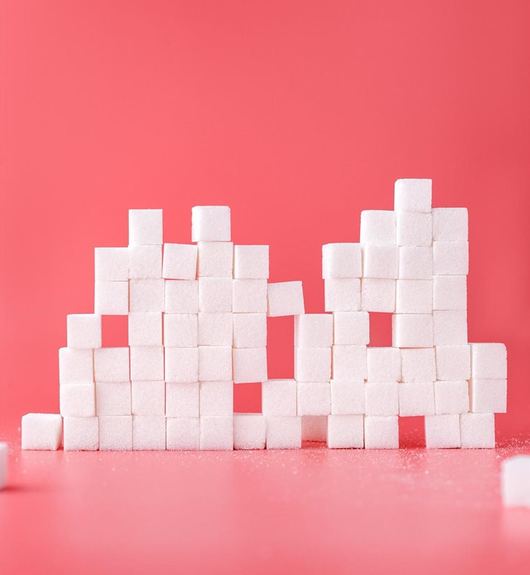
Families of additives for Whiteware
There are several families of additives designed to help technicians to get The proper technical requirements of glazes mentioned before, and to improve quality/quantity of the glazing process:
Deflocculants/Fluidizers
Binders/rheology modifiers
Anti-bacteria agents (preservatives)
Temporary dyes
Flocculants for glaze recovery
Others (suspending agents, antifoam agents, etc.)

Slide 7

Deflocculants/Fluidizers
First, let’s clarify “similar” terms:
Dispersant: the prevailing fluid phase, not an additive (water). Increasing the fluid phase you can have a deflocculant and fluidizing effect
Deflocculant: a substance that avoids flocculation (solid colloidal parts remain in suspension without aggregating)
Fluidizer: substance able to make a fluid flow better reducing its viscosity.
A deflocculant always acts as a fluidizer; not all fluidizers are deflocculants

Slide 8
Deflocculants/Fluidizers
Use and function of deflocculants/fluidizers in Whiteware glaze:
to reduce grinding time
to reduce viscosity maintaining density
to be able to increase density while maintaining viscosity
Usually, there is no need to add deflocculant/dispersant during glaze milling.
For final correction (decrease) of viscosity, you can use Polyacrylates (i.e. Reotan series: Reotan A, Reotan SL)

Slide 9
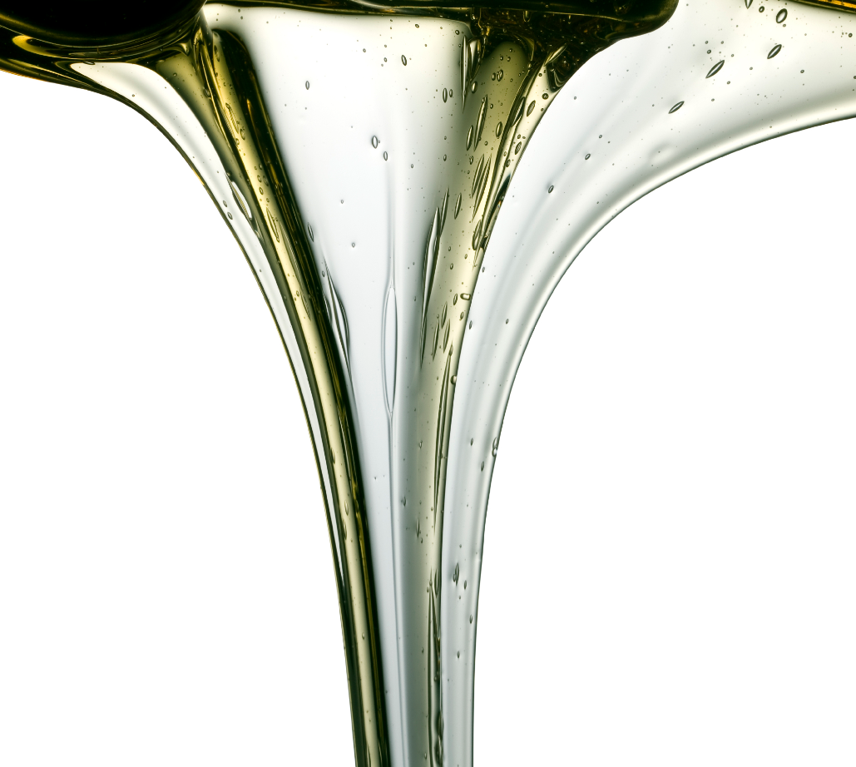
Binders/ Rheology modifiers
Binders/rheology modifiers at work
They mainly operate on two levels:
modification of flow properties of glaze slip (rheology and viscosity)
modification of the flow of water throughout the layer of glaze (adsorption, settling time, and drying time)
They act on the rheological properties of slips and influence the water retention and the permeability of the layer of glaze just after the application.
The balance between these two attitudes gives the final result.

Slide 10
Binders/ Rheology modifiers
Rheological definitions
We can describe the rheological behaviour of glaze slips in a graphical way by two kinds of flow curves showing:
- the relation between viscosity and shear rate (the speed of the flow) where the viscosity is the ratio between force and speed
- the relation between the shear stress (the impelled force) and the shear rate (the resulting speed of the flow)

Slide 11
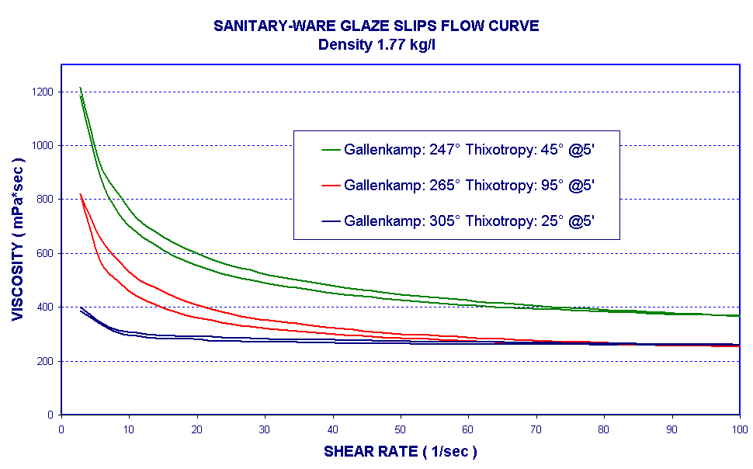
Binders/ Rheology modifiers
Rheological definitions
FLOW CURVE 1
Viscosity v/s Shear Rate

Slide 12
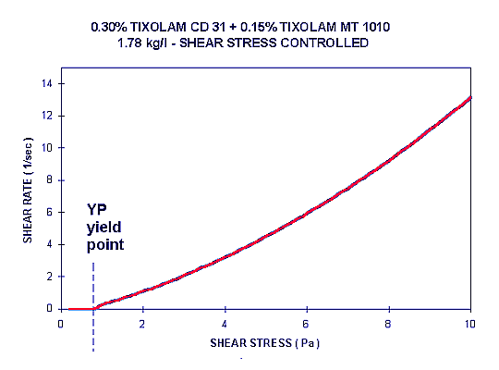
Binders/ Rheology modifiers
Rheological definitions
FLOW CURVE 2
Yield Point approximation:
Rate v/s Stress

Slide 13
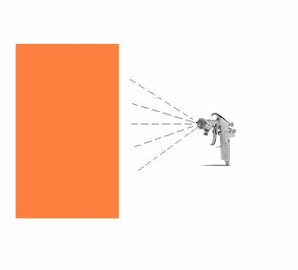
Binders/ Rheology modifiers
Settling the wet glaze
When sprayed glaze slip reaches the surface of the items to be glazed, it loose water by absorption driven by the ceramic body and passes to a gelled phase. Let’s examine this process step by step:
The liquid glaze slip reaches the surface.
As a liquid, it can level itself (good) or run
down (bad).
The rheological properties are important
to reduce or eliminate dropping.

Slide 14
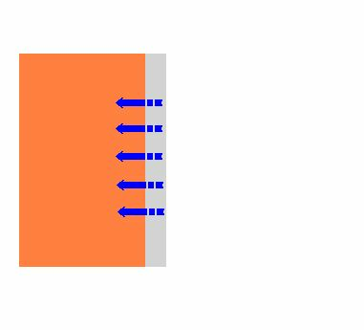
Binders/ Rheology modifiers
Settling the wet glaze
Water starts to be absorbed by the body and the slip turn more or less quickly in a gelled phase, where it is not any longer possible for the glaze to move for leveling or dropping.

Slide 15
Binders/ Rheology modifiers
Settling the wet glaze
Water goes on to be drained by the body and after a certain time the glaze surface is dry enough to receive the following coating of glaze slip.

Slide 16
Binders/ Rheology modifiers
Settling the wet glaze
After the second glazing, the draining of water of fresh glaze slip depends on the absorption properties of the body and of the first coating of glaze

Slide 17
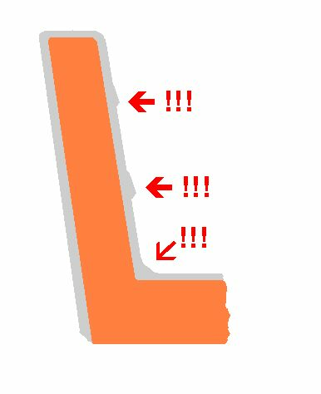
Binders/ Rheology modifiers
Settling the wet glaze
Opposite situations
“A” - The body drains water quickly and/or the glaze slip has poor water retention power:
drying time of the glaze is quick;
there is no or little attitude to dropping or straining the slip;
the self-leveling properties of the glaze slips are poor;
some cracks or defects could occur where the glaze coating is thick
“B” - The body of the first layer of glaze drains water slowly and/or the glaze slip has a strong retention power:
drying time of the glaze is long;
the self-leveling properties of the glaze slips are good;
Glaze slip runs with dropping and straining and excess of glaze in the corners.

Slide 18
Binders/ Rheology modifiers
Settling the wet glaze
It is necessary to balance the water draining capacity of the body and of the glaze and the water retention capacity of the glaze.
We cannot change the absorption of the body, but we can change the water retention of glaze slips and the water permeability of unfired glaze coating by the addition of chemical additives (binders/rheology modifiers).

Slide 19
Binders/ Rheology modifiers
Functions of binders/rheology modifiers:
To increase the cohesion of glaze particles
To create binding action between glaze and body
To control and modify glaze rheology and water flow during storage and application
Side Effects:
Increase of wetting power of dispersant
Reduce sedimentation
Increase viscosity
Increase drying time
Possible foam formation

Slide 20
Binders/ Rheology modifiers
Requirements of binders/rheology modifiers:
Proper rheology according to the glazing system (spraying, dipping, etc)
(see tables 5/6)
Consistency
Lack of impurity
Good dispersibility
User friendly

Slide 21
Binders/ Rheology modifiers
Addition systems:
Powder into the mill (from the beginning or in the last hour of milling).
Advantages = simple
Disadvantages = longer milling, discharge, and sieving time – partial spoiling of the binder due to mechanical and thermal stress – higher risk of bacterial contamination due to early addition.
PS: a partial addition (around 0,05 %) at the beginning of the milling is recommended to have faster milling deflocculant effect) and avoid sedimentation (anti-settling action)

Slide 22
Binders/ Rheology modifiers
Addition systems:
Gel into tanks under high speed stirring
preparing at least 12 hours before a pre-dispersed gel (“mother solution”), usually 4-10 % water solution
Advantages = very good and fast dispersion and homogenization of the binder into the glaze. No loss of binder.
Disadvantages = more complex procedure, greater use of the workforce at different times, middle level risk of bacteria ontamination.
PS: very important to use an antibacterial agent from the beginning in the gel preparation.

Slide 23
Binders/ Rheology modifiers
Addition systems:
Powder into tanks (under high speed stirring)
Advantages = simple, lower risk of bacterial contamination
Disadvantages = longer mixing time – the risk of undissolved binder (loss of material) And longer sieving time with higher residue.
PS: mixing time depends on the shape and dimension of the tank, and on the speed and shape of the stirrer

Slide 24
Binders/ Rheology modifiers
Addition systems:
To choose the addition system take into consideration:
Space, machinery in glaze preparation dept. and output capacity of the plant
Risk of bacterial attacks (quality of water, raw materials, environment, and climate)
Local working organization and skills of the workers.

Slide 25

Binders/ Rheology modifiers
Main families of binders/rheology modifiers:
CARBOCEL = CMC (Na Carboxymethyl cellulose) (powder): traditional binder – very good binding power– longer drying time – lower thixotropy - lower cost - especially recommended for addition in powder form into glaze in tanks
TIXOLAM = SPECIAL BINDER (powder): optimized rheology – shorter drying time –
higher anti-settling properties – higher thixotropy - higher resistance to bacterial attack - higher cost

Slide 26
Binders/ Rheology modifiers
CMC – CARBOCEL® SERIES
 | Active content | DS | Viscosiy 2% Sol. (mPa*s) | pH
Carbocel MM3 | > 98 % | 0.65 - 0.8 | 1000-3000 | 6.5-10
Carbocel MM 500 | > 98 % | > 0.9 | 3000-6000 | 6.5-10
Carbocel AA 100 | > 98 % | > 0.9 | 700-1400 (sol. 1%) | 6.5-9
Carbocel AP 4 | > 98 % | > 0.9 | 1500-2500 (sol. 1%) | 6.5-8.5
Carbocel AG/EHV | > 70 % | > 0.85 | 1000 -1800 (sol 1%) | 6.5-10.5
Carbocel TAM 93 | > 68 % | > 0.85 | 8000-16000 | 6.5 - 8

Slide 27
Binders/ Rheology modifiers
TIXOLAM SERIES
Product Name | Viscosity (2% sol.) | Drying time | Rheology
TIXOLAM CD 31 | 4000 – 6000 cP | long/medium | plastic (with Yield Point)
TIXOLAM AC 83 | 3500 – 6000 cP | medium/long | plastic (with Yield Point)
TIXOLAM RB | 5500 – 7500 cP | long | plastic (with Yield Point)
TIXOLAM MT 1010 | < 1500 cP | short | flat
TIXOLAM AC 162 | 8000 – 14000 cP | long/medium | plastic (with Yield Point)
TIXOLAM AM 01 | 2000 – 3500 cP | short | pseudoplastic (no Yield Point)
TIXOLAM AM 04 | 1200 – 1800 cP (1 % sol) | very short | plastic (with Yield Point)
TIXOLAM AM 113 | 2500 – 5500 cP | medium | plastic (with Yield Point)
TIXOLAM AM 154 | 7500 – 12000 cP | very long | plastic (with Yield Point)

Slide 28
Binders/ Rheology modifiers
PRACTICAL SOLUTIONS
1 product system (1 CMC or 1 Special binder)
2 products system (1 CMC and 1 Special binder or 2 special binders)
The combination of 1 CMC (Carbocel series) and 1 special binder (Tixolam series), with the possibility to change their ratio during different seasons to fit better the different environmental working conditions, can be a good technical and economical compromise.
Total dosages: 0,2-0,45 % on dry glaze content
Always recommended the use of antibacterial agents to improve the consistency of a glaze.

Slide 29
Binders/ Rheology modifiers
PRODUCTS FOR FILLING, FLOWING, AND DIPPING GLAZING
TIXOLAM MT 1010, TIXOLAM 1271, SOSPENSIL B 25 (powder): special binders with low viscosity, “flat” rheology, anti-settling action, and short drying time
READYONE KS: multipurpose additives (binder, fluidizer, anti-settling and antibacterial action)

Slide 30
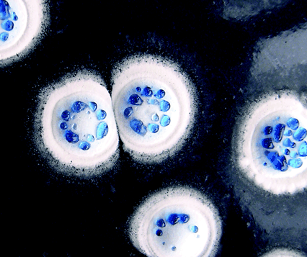
Antibacterial preserving agents
CARBOSAN SERIES
Functions:
Keep consistency of glaze parameters. Binders/rheology modifiers are prone to bacterial attacks (because based on natural polymers). Glaze parameters under bacteria attacks can be suddenly and dramatically spoiled.
Make the most of the properties of the binders
Cleaning and disinfestations of contaminated plants
To be used to prevent, not to cure

Slide 31
Antibacterial preserving agents
CARBOSAN SERIES
Actions
Kill the colonies of bacteria, fungi, molds, and yeasts that produce enzymes that “break” binder polymers, causing sudden changes of glaze parameters or causing other defects or uneasiness for the worker (i.e: bad odor)
Preventing action: If enzymes are already in the glaze, their effects will go on for some time. To get back in a short time to a “safe” situation, it is necessary a deep clean of all the glazing lines.
Standard dosage: 0,1 – 0,2 % on total glaze
Addition: 20-30 % into ball mill, 80-70 % just before binder addition

Slide 32
Antibacterial preserving agents
CARBOSAN SERIES
Warnings:
Lamberti prefers to offer products in liquid form, which are easier to manage about dosing and worker health protection
Always use proper PPE (Personal Protection Equipments) as prescribed in SDS
In some countries products releasing Formaldheyde are not allowed anymore or require special health controls on workers
Pay attention to transport hazard class
Alternate products based on different chemicals to avoid adaptation

Slide 33

Temporary organic dyes
NEOPRINT / LAMPRINT SERIES
To recognize/mark glazes
To highlight the uniform distribution of the glaze
No traces after firing
Several colors available
Dosages= 0,01 – 0,1 % on total glaze

Slide 34
Media for decals application
DECALFIX /ECOFIX SERIE
Easy to be applied
Very good definition of decals (decoration, logo, bar code)
No “shades” after firing
No distortion during application
DECALFIX NEW and ECOFIX NEW
ECOFIX NEW is the new version: not flammable not labeled as dangerous and flammable; it can be shipped and stored without special requirements

Slide 35
Reserving agents
LAMWAX SERIES
Used for special multicolored items
To avoid glaze application in a specific area of the item.
Very clear and defined limits

Slide 36
Defoaming and anti-settling agents
DEFOMEX , TENSIOL AND SOSPENSIL SERIES
- Defomex and Tensiol Series: to prevent the formation of foam or to reduce existing foam.
- Sospensil Series: when necessary to avoid hard settling and sedimentation of glaze slips

Slide 37
Flocculant for recovered glazes
REOTAN FLOC SERIES
Less effective on glaze parameters after mixing recovered and fresh glaze.
Lower health and safety labeling compared with other products used for the same purpose.
Dosages 0,35 -0,55 % on dry content

Slide 38
Visit us: link

